Slide 1

HYPERTUNING
PARAMETERS
changing hidden layers, activation function, loss function, regularization & dropout.
1
2
RESULTS
using write.csv() to output the results into a CSV file.
IMDB - HYPERTUNING
DESIGNING WITH TABLEAU
transforming values & using multiple customization options for a neat graphic.
Advanced Machine Learning
3
4
EXPORTING GRAPHICS
into a png file for high quality.
5
CREATING PRESENTATION
explaning process and presenting the story.

Slide 2
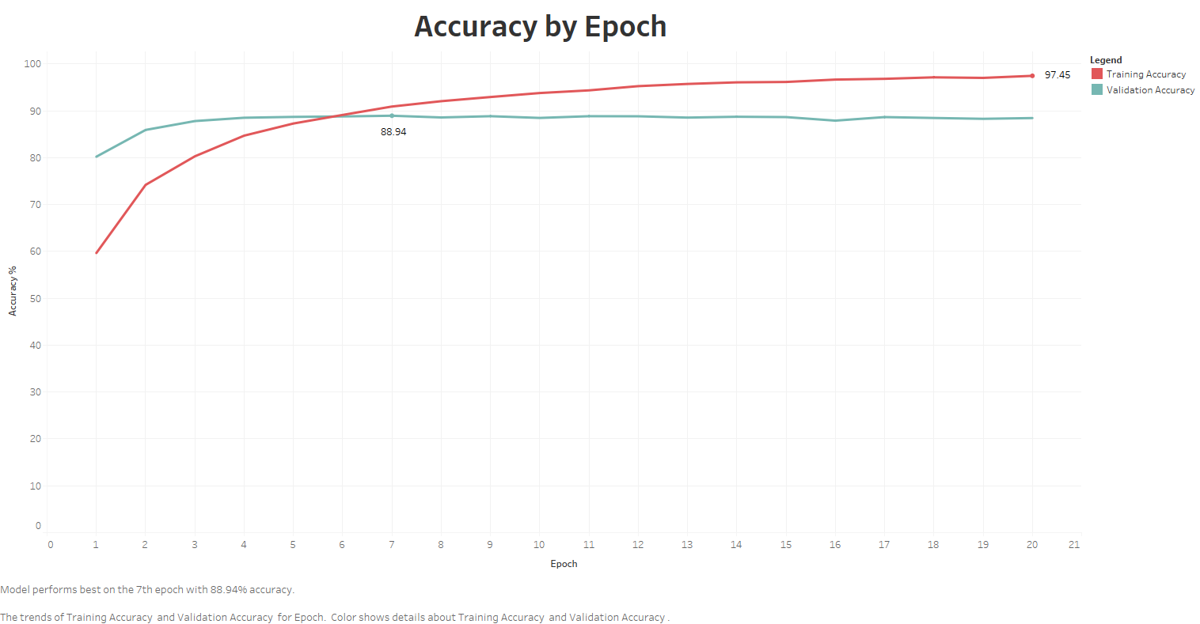

Slide 3
